Slide 1
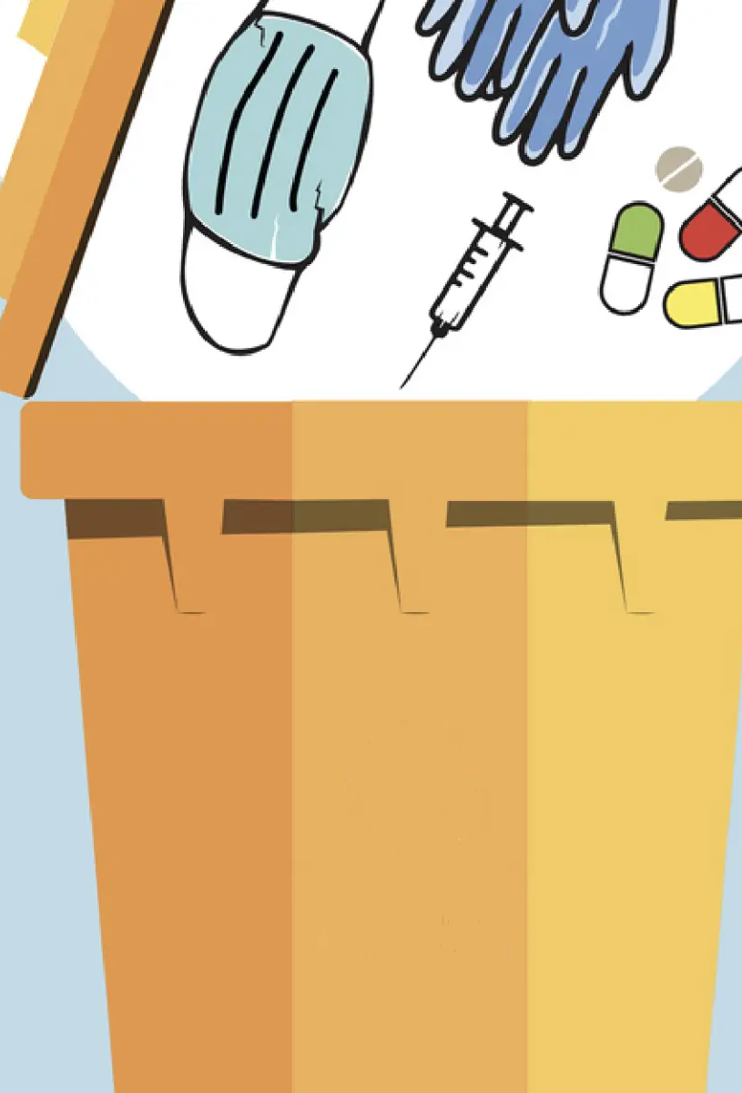
Hospital Waste Management AI Agent System
Smart Waste, Safe Planet!

Slide 2

Introduction
Biomedical waste poses serious health & environmental risks if mismanaged
Hospitals generate multiple waste categories requiring strict segregation
Errors in segregation can lead to infections, regulatory penalties, and environmental harm
Need for automated, real-time validation to improve compliance
Project aligns with SDG 12 – Responsible Consumption and Production

Slide 3

Goal: Ensure sustainable consumption and production patterns globally.
Key Focus:
Efficient resource use
Reduction of waste generation
Safe disposal and recycling of hazardous materials
Healthcare Relevance:
Biomedical waste can harm both environment and public health if not managed properly.
Hospitals play a crucial role in achieving SDG 12 targets.
Relevant SDG Targets for This Project:
Target 12.4: Environmentally sound management of chemicals and all wastes.
Target 12.5: Substantially reduce waste generation through prevention, reduction, recycling, and reuse.
Target 12.8: Relevant information and awareness for sustainable development.

Slide 4

The Challenge of Biomedical Waste in Hospitals
High Risk:
Biomedical waste contains infectious, hazardous, or recyclable materials.
Incorrect disposal can spread infections and pollute the environment.
Common Issues in Hospitals:
Mis-segregation: Waste placed in the wrong category (e.g., gloves in yellow bin instead of red).
Manual Errors: Human oversight during collection and categorization.
Lack of Real-Time Checks: Errors identified only after disposal.
Impact:
Health hazards for hospital staff, patients, and the community.
Increased treatment and disposal costs.
Violation of biomedical waste management regulations.

Slide 5
Waste Category Colour | Type of Waste | Examples | Disposal Method
Yellow | Infectious & Pathological Waste | Soiled dressings, cotton swabs, infected gloves, human anatomical waste (tissues, organs), blood bags, body fluids | Incineration or deep burial
Red | Contaminated Waste Suitable for Recycling | Tubing, catheters, IV sets, syringes (without needles), gloves, masks (non-infectious plastics) | Autoclaving and Shredding/recycling
White (Translucent) | Sharps (Needles, Scalpel Blades, Glassware) | Needles, scalpels, blades, broken glass | Disinfection (chemical/thermal) and shredding or encapsulation
Blue | Glassware & Metallic Implants | Glass vials, ampoules, metallic body implants | Disinfection and then recycling or safe disposal
Black | General Non-Hazardous Waste | Paper, plastic wrappers, packaging, non-contaminated waste, vegetable waste | Landfill or municipal solid waste disposal or recycling

Slide 6
Objectives of the AI Agent Waste Management System
Automate Waste Validation
Use AI to instantly check if waste category matches waste description.
Reduce Segregation Errors
Identify and report mis-segregated waste in real-time to the concerned staff.
Ensure Correct Disposal Routing
Automatically route validated waste for internal processing or external vendor pick-up.
Improve Accountability
Maintain logs of errors and send feedback to the source department.
Support SDG 12 Compliance
Promote safe disposal, recycling, and resource-efficient waste handling in hospitals.

Slide 7
Data Collection Using Google Form
Captures essential details for every biomedical waste entry:
Email (Responder)
Date & Time of Collection
Department Name (OPD, IPD, OT, ICU, Pathology, Radiology, Pharmacy)
Waste Category (Yellow, Red, White, Blue, Black)
Waste Description (e.g., infected cotton, glove box)
Weight (Kg)
Disposal Method (Internal or External)

Slide 8
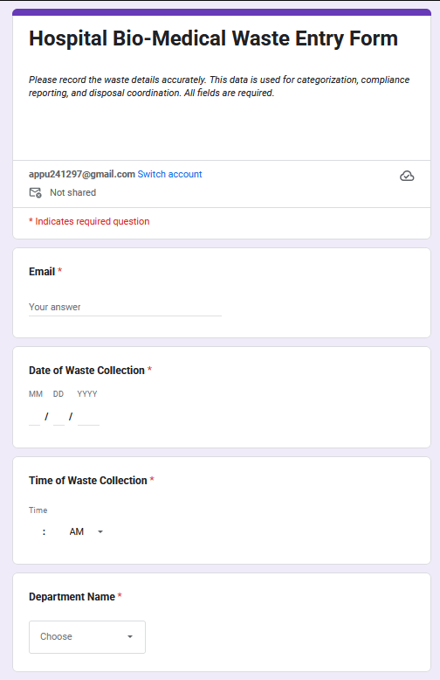
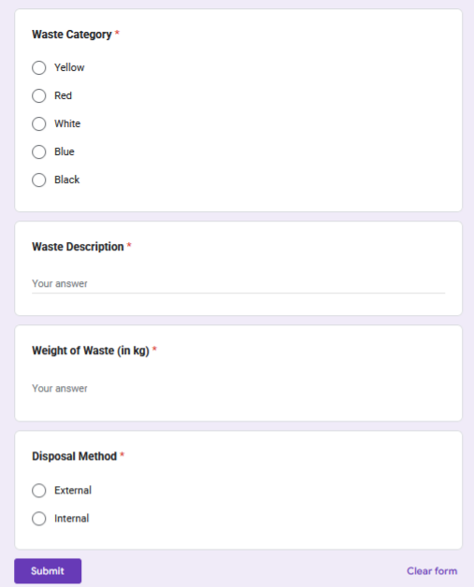
LINK- https://forms.gle/MmCFbwiCj8PtxyuB6

Slide 9
Function: Validates if the Waste Category matches the Waste Description from the form.
Examples: Infected cotton → Yellow category Glove box → Black category
Routing Logic: If Mismatch → Waste Segregation Error If Match + Internal Disposal → Internal Route If Match + External Disposal → External Route
Output: One-word response → Error, Internal, or External
AI AGENT 1: HOSPITAL WASTE ROUTING & VALIDATION

Slide 10
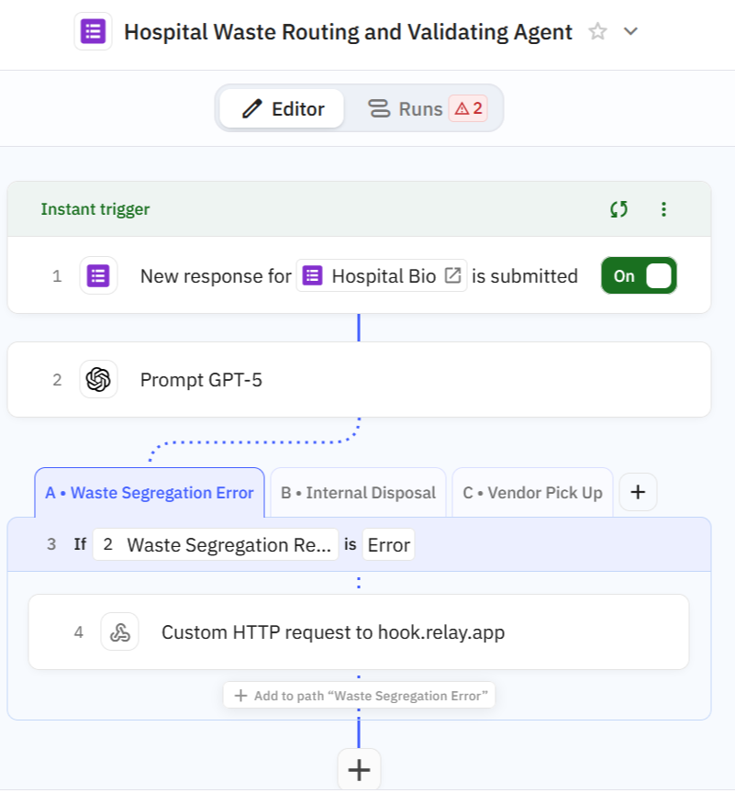
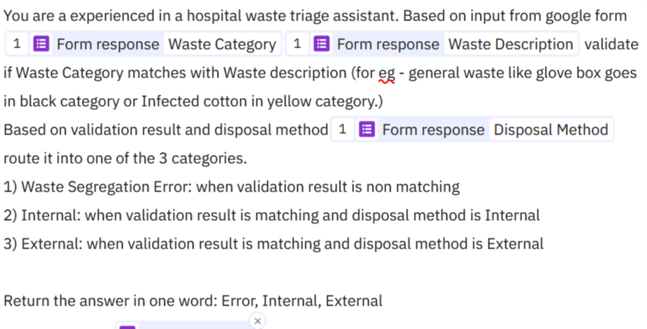

Slide 11
Triggered when Error is identified by the validation agent.
Actions: -Logs error details (date, time, department, waste category & description, weight, email) into an Excel error log. -Sends an automated email notification to the form responder, informing them about the segregation error and requesting corrective action.
Goal: Reduce repeated errors through timely feedback and staff awareness.
AI AGENT 2: Segregation Error Logging & Reporting

Slide 12
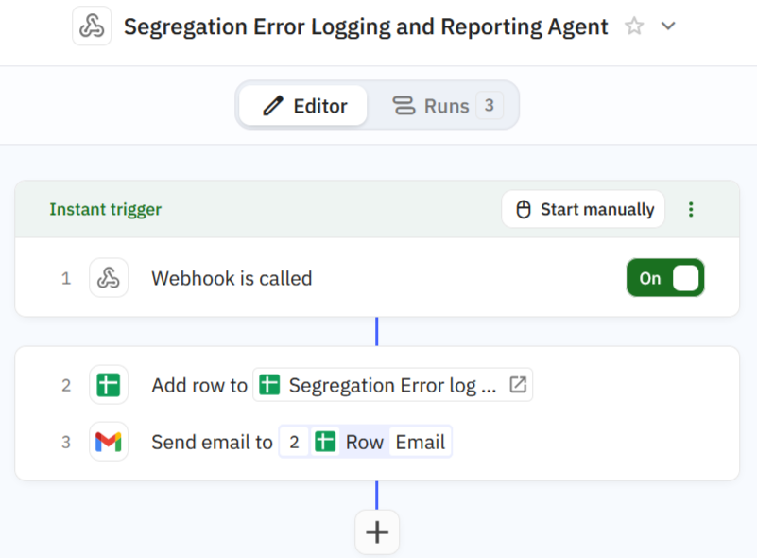
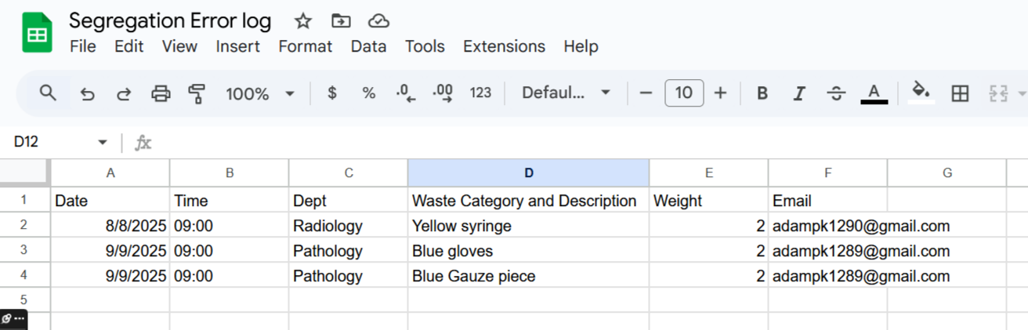
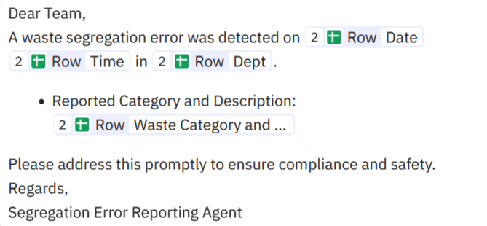

Slide 13
Triggered for waste validated as correct and marked for Internal Disposal.
Collects key data (waste category, description, weight, department, date).
Uses AI to summarize the data and generate actionable recommendations for the internal disposal team.
Automatically emails the summary and recommendations to the Internal Disposal Authority for timely action.
AI AGENT 3: Internal Disposal Agent

Slide 14
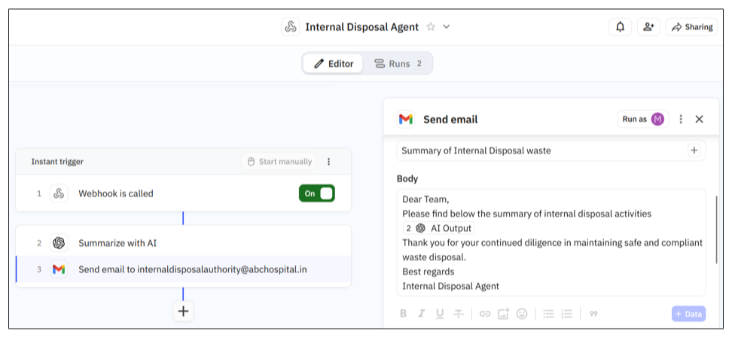

Slide 15
Activated for waste validated as correct and marked for External Disposal.
Routes waste based on category:
Incineration Team: If waste category is Yellow
Waste Recycling Team: For all other categories
Sends notification emails to the respective teams, including:
Request to collect waste from designated collection areas (Area 1 for Incineration, Area 2 for Recycling)
Waits for confirmation or reply from teams to ensure collection.
AI AGENT 4: External Disposal Agent

Slide 16
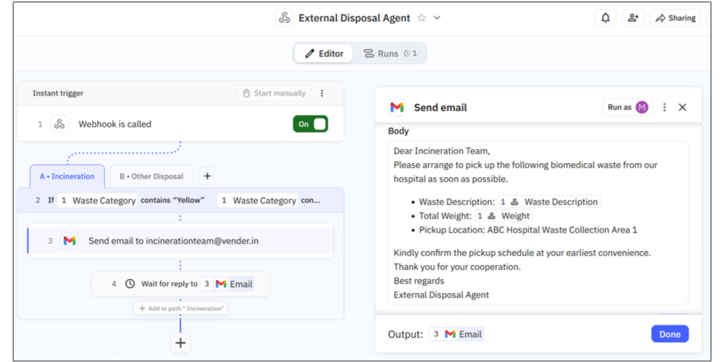

Slide 17
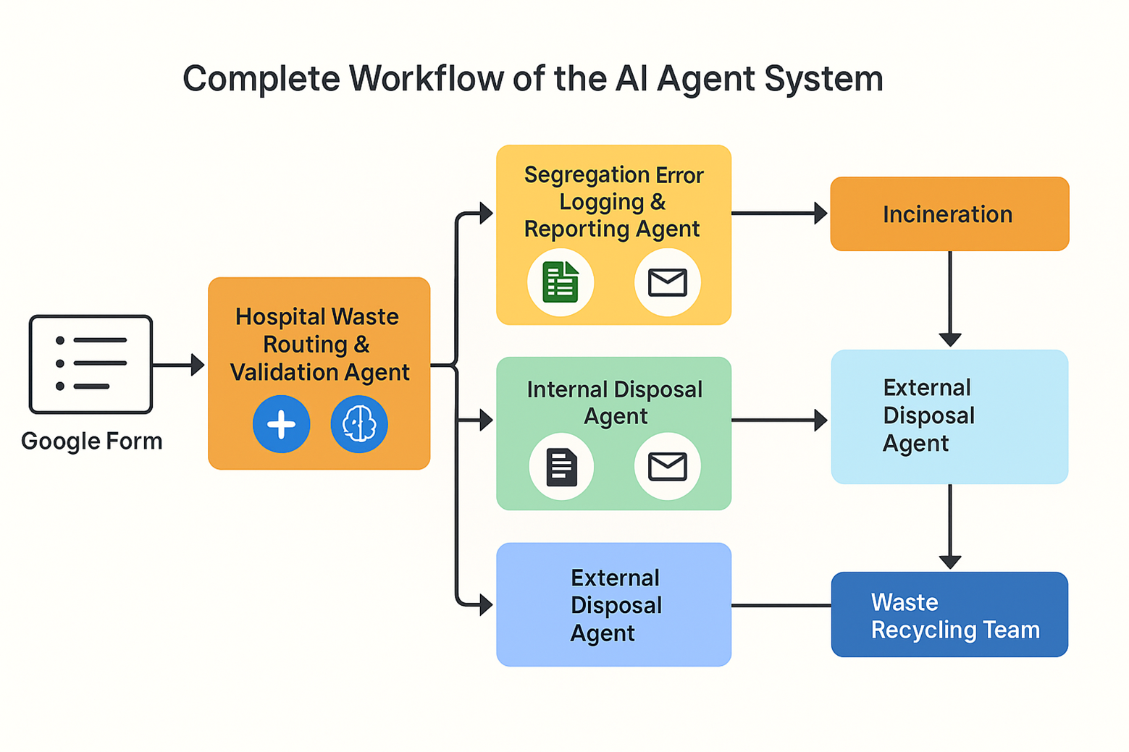

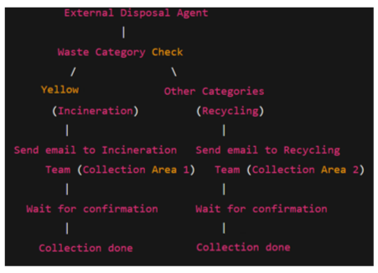

Slide 18
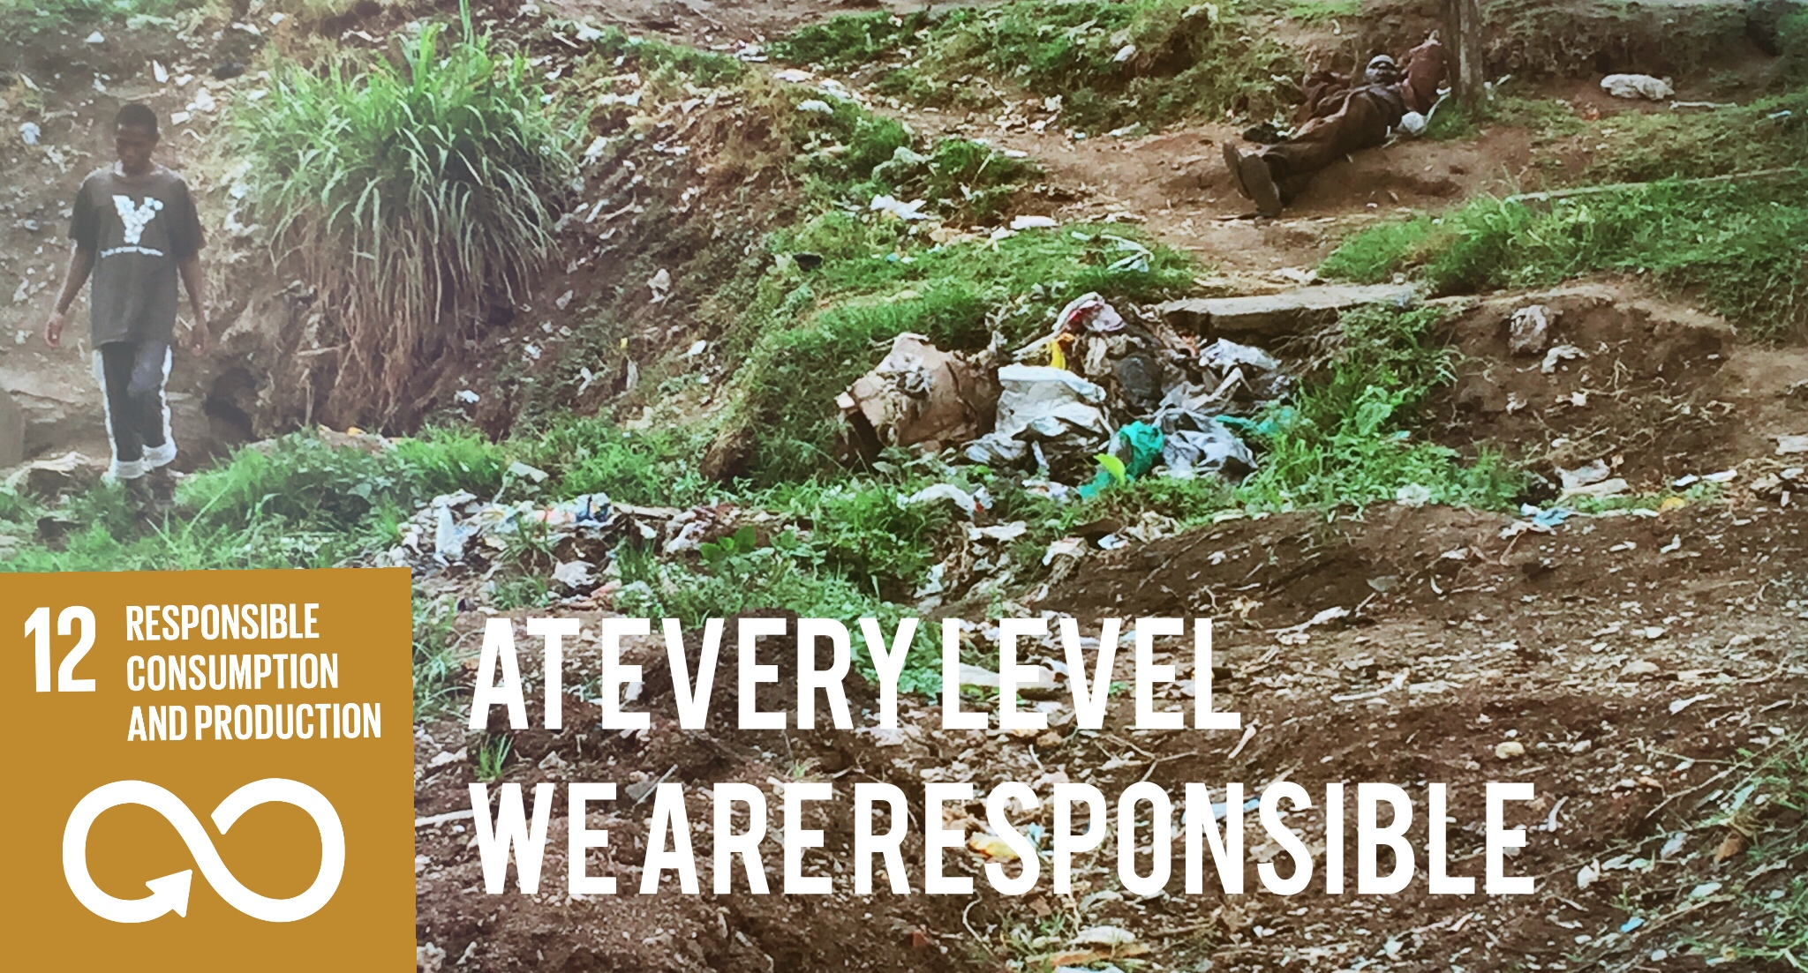
Supports SDG Target 12.4: “By 2020, achieve environmentally sound management of chemicals and all wastes throughout their life cycle.” — Ensures biomedical waste is segregated and routed properly to reduce environmental hazards.
Contributes to SDG Target 12.5: “Substantially reduce waste generation through prevention, reduction, recycling and reuse.” — Minimizes segregation errors and promotes correct disposal to reduce hospital waste contamination and volume.
Promotes SDG Target 12.8: “Ensure that people everywhere have the relevant information and awareness for sustainable development.” — Through automated error notifications and reporting, raises awareness among hospital staff about correct waste handling.
Additional Benefits:
Improves patient and staff safety by preventing hazardous waste mishandling.
Enables data-driven decision making via logged reports and summaries.
Reduces operational costs by optimizing disposal processes.

Slide 19
Future Enhancements & Scalability
Real-time Dashboard: Interactive visualization of waste segregation errors, disposal statuses, and departmental compliance trends.
Hospital ERP Integration: Seamless connection with hospital management systems for automated waste data capture and compliance reporting.
Predictive Analytics: Using historical data to forecast waste generation patterns and optimize resource allocation.
Enhanced AI Validation: Train custom machine learning models on validated data for faster, more accurate waste category predictions.
Feedback & Training Modules: Automated suggestions and tailored training content for departments with frequent segregation errors.

Slide 20





Conclusion &
Call to Action
The AI Agent framework effectively automates biomedical waste validation and routing, reducing errors and improving disposal compliance.
Aligns strongly with SDG 12 by promoting responsible consumption, waste reduction, and sustainable hospital practices.
Enables safer hospital environments, better resource management, and environmental protection.
Call to Action: Encourage hospitals to adopt AI-driven waste management systems to meet sustainability goals and enhance operational efficiency.

Slide 21
MADE BY
Dr. Mathew Abraham (TEAM LEADER)
Dr. Aditya Maheshwari
Nishi Jacob
Santosh Soumyadarshi Dash
Samaresh Ghorami

